Slide 1

AI/ML in Credit Card Fraud Detection
Exploring how artificial intelligence and machine learning are revolutionizing the fight against financial crime in the digital age.
P.PAVANI - 322129512049

Slide 2
Agenda
01
02
03
The Problem: Rising Fraud
AI/ML Solutions
Advantages of AI/ML
Understanding the challenges in the digital financial ecosystem.
How AI and ML address modern fraud complexities.
Key benefits of implementing advanced detection systems.
04
05
06
Disadvantages & Challenges
AI Tools & Techniques
Future Scope
Acknowledging the limitations and hurdles.
Specific technologies driving fraud detection.
What's next for AI/ML in fraud prevention.
07
Conclusion
Summarizing key insights and the path forward.

Slide 3

The Problem: The Escalating Threat of Credit Card Fraud
Credit card fraud has become a critical challenge in the digital financial ecosystem. The rapid growth of online transactions, mobile banking, e-commerce, and contactless payments has significantly amplified the risk of fraudulent activities.
These illicit schemes lead to substantial financial losses, erode consumer trust in digital payment systems, and impose heavy operational and reputational burdens on financial institutions and merchants.

Slide 4

Limitations of Traditional Fraud Detection Systems
Traditional systems, relying on predefined rules and static thresholds, are no longer adequate against modern, sophisticated fraud schemes. They struggle in two primary areas:
High Rate of False Positives
Failure to Detect Emerging Patterns
Legitimate transactions are frequently flagged as fraudulent. This not only frustrates genuine customers but also leads to revenue losses for merchants and damages customer loyalty.
Traditional systems often miss dynamic, well-hidden, and technologically sophisticated fraud patterns. Fraudsters exploit stolen card details, phishing, skimming, account takeovers, and even AI-powered scams that mimic real user behavior, making detection increasingly complex.

Slide 5
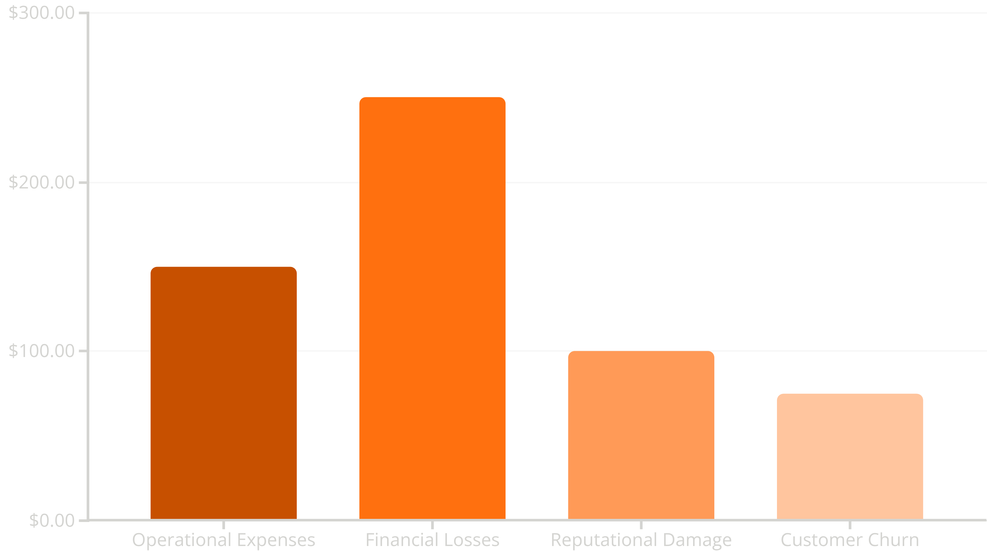
The Cost of Manual Investigation
Beyond detection failures, the manual investigation of fraudulent transactions remains a costly and time-consuming process for banks and merchants. Heavy reliance on human intervention significantly increases operational expenses and slows down the response time to active fraud.
This chart illustrates the significant financial impact of credit card fraud, highlighting the various cost factors incurred by financial institutions and merchants.

Slide 6
Advantages of AI/ML in Fraud Detection
Real-time Detection
Adaptive Learning
AI/ML models can process vast amounts of data instantly, identifying suspicious patterns as transactions occur, significantly reducing fraud response time.
Unlike static rules, AI/ML systems continuously learn from new data, adapting to evolving fraud tactics and emerging patterns without constant manual updates.
Reduced False Positives
Enhanced Accuracy
Advanced algorithms can differentiate between legitimate and fraudulent activities with higher accuracy, minimizing disruptions for genuine customers.
AI/ML can analyze complex relationships and subtle anomalies that human analysts or traditional systems might miss, leading to more precise fraud identification.

Slide 7

Disadvantages & Challenges of AI/ML Implementation
Data Dependency
Model Explainability
AI/ML models require large volumes of high-quality, labeled data for training, which can be challenging to acquire and maintain, especially for rare fraud types.
Complex AI models (e.g., deep learning) can be "black boxes," making it difficult to understand why a particular transaction was flagged, which is crucial for regulatory compliance and dispute resolution.
Computational Resources
Adversarial Attacks
Training and deploying sophisticated AI/ML models demand significant computational power and infrastructure, leading to higher operational costs.
Fraudsters can attempt to trick AI models by generating "adversarial examples," making legitimate transactions appear fraudulent or vice-versa, requiring continuous model updates and security measures.

Slide 8

Key AI Tools and Techniques Used
A variety of AI and ML techniques are employed to build robust fraud detection systems:
Machine Learning Algorithms: Supervised learning (e.g., Logistic Regression, Support Vector Machines, Random Forests, Gradient Boosting) and Unsupervised learning (e.g., K-Means Clustering, Anomaly Detection).
Deep Learning: Neural Networks, Recurrent Neural Networks (RNNs) for sequential data, and Convolutional Neural Networks (CNNs) for complex pattern recognition.
Natural Language Processing (NLP): For analyzing text data in transaction descriptions or customer communications to identify suspicious language.
Graph Neural Networks (GNNs): To detect fraud rings and complex relationships between entities (users, merchants, devices) in transaction networks.
Feature Engineering: Creating new, more informative features from raw transaction data to improve model performance.

Slide 9
Future Scope of AI/ML in Fraud Detection
The evolution of AI/ML promises even more sophisticated fraud prevention:
Explainable AI (XAI): Developing models that can provide clear reasons for their decisions, enhancing trust and compliance.
Behavioral Biometrics: Analyzing unique user behaviors (typing patterns, mouse movements) to authenticate users and detect anomalies.
Federated Learning: Training models on decentralized datasets without sharing raw data, improving privacy and collaboration across institutions.
Quantum Machine Learning: Leveraging quantum computing for faster and more complex fraud pattern recognition in the long term.
Reinforcement Learning: Creating autonomous agents that learn optimal strategies for fraud detection and prevention through trial and error.
Real-time Adaptive Models: Systems that can update and retrain themselves continuously in real-time to combat rapidly evolving fraud tactics.

Slide 10
Conclusion: The Indispensable Role of AI/ML
AI and Machine Learning are no longer just tools but essential pillars in the fight against credit card fraud. They offer unparalleled capabilities in real-time detection, adaptive learning, and accuracy, far surpassing the limitations of traditional systems.
While challenges like data dependency and model explainability persist, ongoing advancements in XAI, federated learning, and behavioral biometrics promise to make these systems even more robust and transparent. Embracing AI/ML is crucial for financial institutions to protect consumers, maintain trust, and secure the digital economy against increasingly sophisticated threats.

